Slide 1




HEALTHY FOOD
BELONGS TO
EVERYONE
What if you could help others eat
better, just by eating better yourself?

Slide 2




SOLVING A GLOBAL EPIDEMIC
How do you eat better with limited resources, skills or time?
Well. You don’t
BAD DIETS KILL MORE PEOPLE GLOBALLY THAN TOBACCO
INDIVIDUALS PAY THE HIGHEST PRICE – POOR HEALTH
EXPENSIVE
FOR SOCIETIES
POLARISATION
OF WELLBEING

Slide 3


OUR AWARD WINNING SOCIAL
INNOVATION
CONNECTS THOSE WHO WANT
TO EAT HEALTHY VEGETARIAN FOOD TO THE ONES WHO ARE FOOD INSECURE
The ones who can, support the ones who need help.
Everyone wins and eats well.

Slide 4



VENNER OPERATES IN
GROWING MARKETS
B2C
B2B
B2G
Global need for ecological, economical and healthy dietary habits to reach every SES
CSR & Employer brand, Employee wellbeing.
Food aid as an investment to public health and education – to a systemic change.
Urgent need for solutions with impact on wellbeing to fight food poverty and obesity.

Slide 5


VTT FINDS FOOD ENVIRONMENT AT HOME TO BE MOST IMPACTFUL:
Stronger instruments than school meals need to be adopted to ensure wellbeing. Unhealthy eating is especially damaging for growing and developing children and young people. Adults are responsible for the eating environment of children and young people and for the eating habits it directs.
  “The capital invested in the food environment is best recovered in society sevenfold”
  - Eeva Rantala, researcher, from VTT

Slide 6

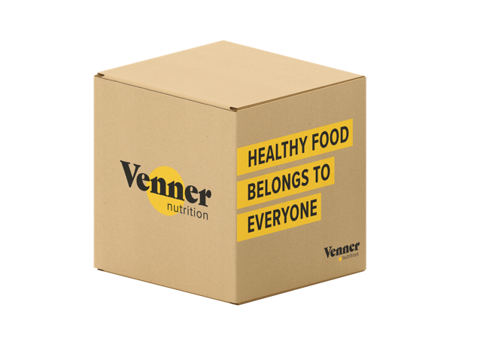

EMPOWERING SOLUTION:
VENNER NUTRITION BOX + EDUCATION
ALWAYS
HOME DELIVERED
FOR THE FAMILY
IN NEED!
Carefully planned veggie food box:
Ingredients up to 6 people for a week
Fruits, snack recipes
Booklet with simple inspiring recipes
Vitamin D supplement
Admission to e-cooking course
Home delivery

Slide 7

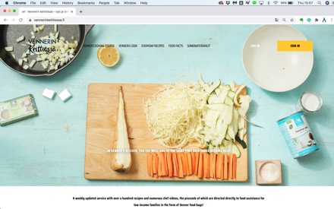
EMPOWERING EDUCATION :
VENNER’S KITCHEN PLATFORM
Disrupting the way we help others
THE REVENUE IS USED FOR PROVIDING VENNER NUTRITION BOXES TO UNDERPRIVILEGED FAMILIES
For 9.90€/month one gets:
Cooking courses
Intuitive recipe archive
Celebrity Venners’ cooking videos
Tips to eat seasonal
Food waste tool
Shopping lists
Carbon footprint calculator

Slide 8
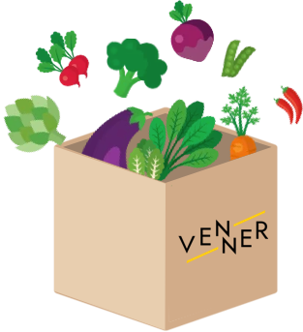
MONTHLY
VENNER SEASONAL BOX
FOR EMPLOYEE
WELLBEING
Carefully planned seasonal veggie food box
For B2B – wellbeing, new skills,
sustainable cooking
Ingredients up to 4 people, 3+1 recipes
New skills, seasonal veggie ingredients, sustainable eating
Booklet with simple inspiring recipes + e-cooking course
Home delivery
Supporting the good cause: part of the profit used for Venner Nutrition Boxes for families in need
Product launch in Finland for
Christmas season 2020!

Slide 9


IMPACT AMONG FOOD INSECURE FAMILIES
NUTRITION EDUCATION
CREATES HUGE
ROI & IMPACT
Learned new skills
Committed to taking better care of their daily diet
82%
78%
Said that VNB provided relief from a challenging life situation
Added at least one of the recipes into their weekly food plan (almost 70% before COVID – the crisis influenced this)
99%
58%
Of the families who didn’t eat together before now eat together more as a family
(n = 787 families in Finland, after one or two Venner Nutrition box / boxes)
44%

Slide 10


4 TARGET GROUPS,
OUR SOLUTION
B2C
B2B
B2G
LOW SES
FAMILIES
ORDER FOR YOURSELF/MEAL KIT SERVICE
ORDER FOR A FAMILY IN NEED
SUBSCRIPTION
TO PLATFORM (FUNDS → VNB)
ORDER FOR EMPLOYEES / WELLBEING
CSR / TRANSPARENT WAY OF HELPING
FOOD AID AS AN INVESTMENT TO PUBLIC HEALTH
FOOD EDUCATION TO FIGHT OBESITY
RECEIVING FOOD
BOX FOR FREE
RECEIVING PLATFORM EDUCATION FOR FREE
→
ENHANCED WELLBEING, REDUCED COSTS

Slide 11



DISRUPTING FOOD INSECURITY AND OBESITY IN MODERN COUNTRIES
SOCIAL IMPACT STARTUP THAT
CREATES A NEW TYPE OF VALUE CHAIN,
WHERE EVERYONE INVOLVED BENEFITS!
THE PLANET – EATING PLANT BASED AT LEAST ONCE A WEEK REDUCES GREENHOUSE GASES
BY 8,6%/YEAR
(estimation, U.K)
THE SPONSORS;
THE ONES PAYING
AND GETTING VALUE OF THE SERVICE
THE ONES IN NEED OF HELP; GETTING VALUE FROM THE SERVICE WITH NO CHARGE
THE SOCIETY – REDUCED COSTS IN THE PUBLIC HEALTH, ENHANCED PRODUCTIVITY
WIN
WIN
WIN
WIN

Slide 12

VENNER TODAY
Provided and sold ̰ 11 000 Nutrition Boxes
11 celebrity ambassadors “Venners”
(+ 4 already in UK)
Two food e-commerce partners, piloting solution with Waitrose in U.K
(K-ryhmä and Kauppahalli24 in Finland)
Won the "Most impactful act of year 2019" award in Finland by Arvo ry
– a coalition for social enterprices
Over 100 companies and foundations as
CSR partners, trials with municipalities in Finland and in U.K.
Venner is a social enterprise – we have the right to use the “Social Enterprise” mark by Suomalaisen Työn liitto.
Several monthly paying content partners
from the food industry
Venner Nutrition Ltd founded in UK, July 2020

Slide 13




SOCIAL INNOVATION
The only nutrition focused, plant-based food solution that provides environmentally friendly education for a lasting social impact – among two different target groups!
COVID-19 makes us more needed than ever
Food-aid should be an investment to health,
immunity and education.

Slide 14
"For the first time in years I've felt like I'm part of a normal society. You change the world, one family at time."
– Venner family feedback
- Tuulia Järvinen, Co-Founder, Venner

