Slide 1
Strategic foresight
– Organizational barriers and leadership principles
Nando Malmelin
SHIFT Business Festival

Slide 2
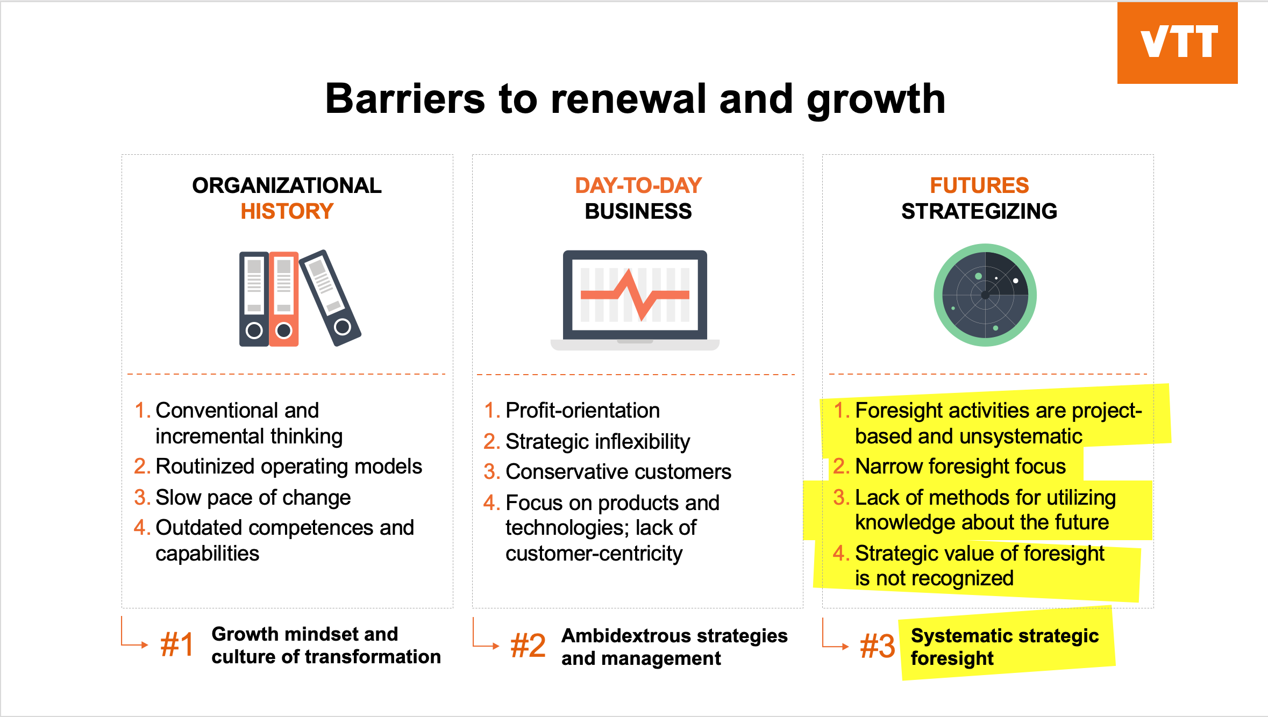

Slide 3
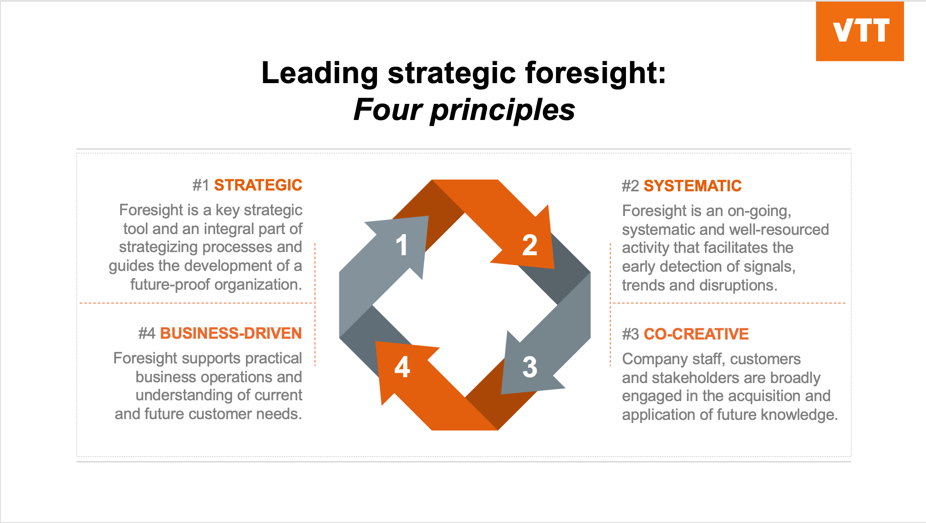

Slide 4
CONTACT:
Nando Malmelin, PhD
Professor of Practice, Disruptive Business
nando.malmelin@vtt.fi
+358405248094
fi.linkedin.com/in/nandomalmelin

