Slide 1
The implementation of circular economy Ten lessons learned
Prof. dr. Jacqueline Cramer, Holland Circular Hotspot

Slide 2
I have gained experiences in numerous circular economy initiatives
Regional circular economy programme in:
Two main strategies
High-value recycling and reuse of major resource streams
Circular procurement
Initiatives of product chains
Redesign and recycling of mattresses
Sustainable concrete (50% CO2
reduction, 100% recycling in 2030)
Sustainable fashion (integrating
concepts of slow fashion in fashion
brands)
Metropolitan Region Amsterdam

Slide 3
Lessons learned (1)
SPARKING THE TRANSITION
1
2
3
4
The transition starts with a shared sense of urgency. No actor can realize a circular initiative alone
The implementation of circular initiatives occurs in four subsequent, but cyclic phases (preparing, building, scaling and mainstreaming circular initiatives)
The tasks to be performed for each circular initiative are roughly the same, but the focus is case specific
Building a circular economy is a journey with a clear destination, but without a predetermined path

Slide 4
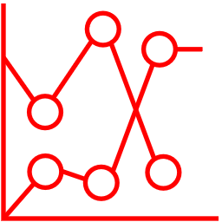
Lessons learned (2)
CONTEXT IS KEY
5
6
7
Focus on the most promising and far-reaching innovations. Select frontrunners in industry as lead
Map the key drivers and preconditions for successful implementation at the start
Identify the relevant actors and assess their willingness to join forces at the start

Slide 5
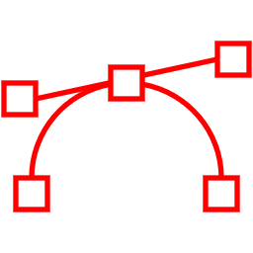
Lessons learned (3)
SUCCESSFUL IMPLEMENTATION
8
9
10
Develop new circular business models that benefit all consortium partners
Orchestration through intermediaries (‘transition brokers’) can accelerate circular initiatives
Build a consortium of relevant network partners and agree upon a transparent division of labour
Focus of next page

Slide 6
10. Build a consortium of relevant network partners and agree upon division of labour
Research and educational
institutions and consultancies
Technology development and optimisation
Socio-cultural changes
Government, business, research
and educational institutions, NGOs and civil society
System orchestration with transition brokers
Government at EU, national, provincial and city level
Creation of preconditions
Market creation
Businesses (including the financial sector)
New form of ‘network governance’

