Slide 1
How can Circular Economy and Fair Data Economy help to rebuild your company post-Corona?
SHIFT Business Festival 2020
Jaana Sinipuro, Project Director, Sitra
@jsinipuro

Slide 2
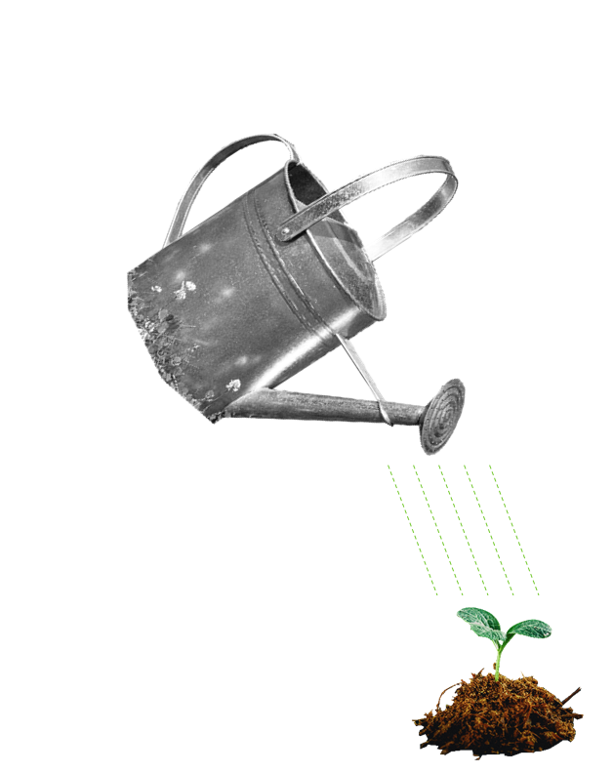
Sitra in a nutshell
Sitra toolbox
A gift from Parliament to the 50-year-old Finland 51 years ago. Still under the direct control of the Finnish Parliament.
A think, do and connect tank. An independent future house.
Works towards a fair and sustainable future.
Funded by returns on endowment capital and capital investments.
The vision is implemented by three themes and hundreds of projects.
“Sense making”
Starting a societal debate and spreading awareness
Forging encounters, uniting people
Practical trials and pilots
Spreading and establishing new operating models
Building a political and administrative foundation for change
… Building our future together.

Slide 3
SITRA’S MEGATRENDS 2020
New tribes and communities
The population is ageing and diversifying
Relational power is strengthening
Fair or unequal transition?
Centralised decisions or broad engagement?
Ecological reconstruction
is a matter of urgency
Sustainability gap
Power over the future
The environment as a resource or improving the state of the environment?
Are solutions opportunities or threats?
The economy is seeking direction
Technology is becoming embedded in everything
Change in work and consumption

Slide 4
background

Slide 5
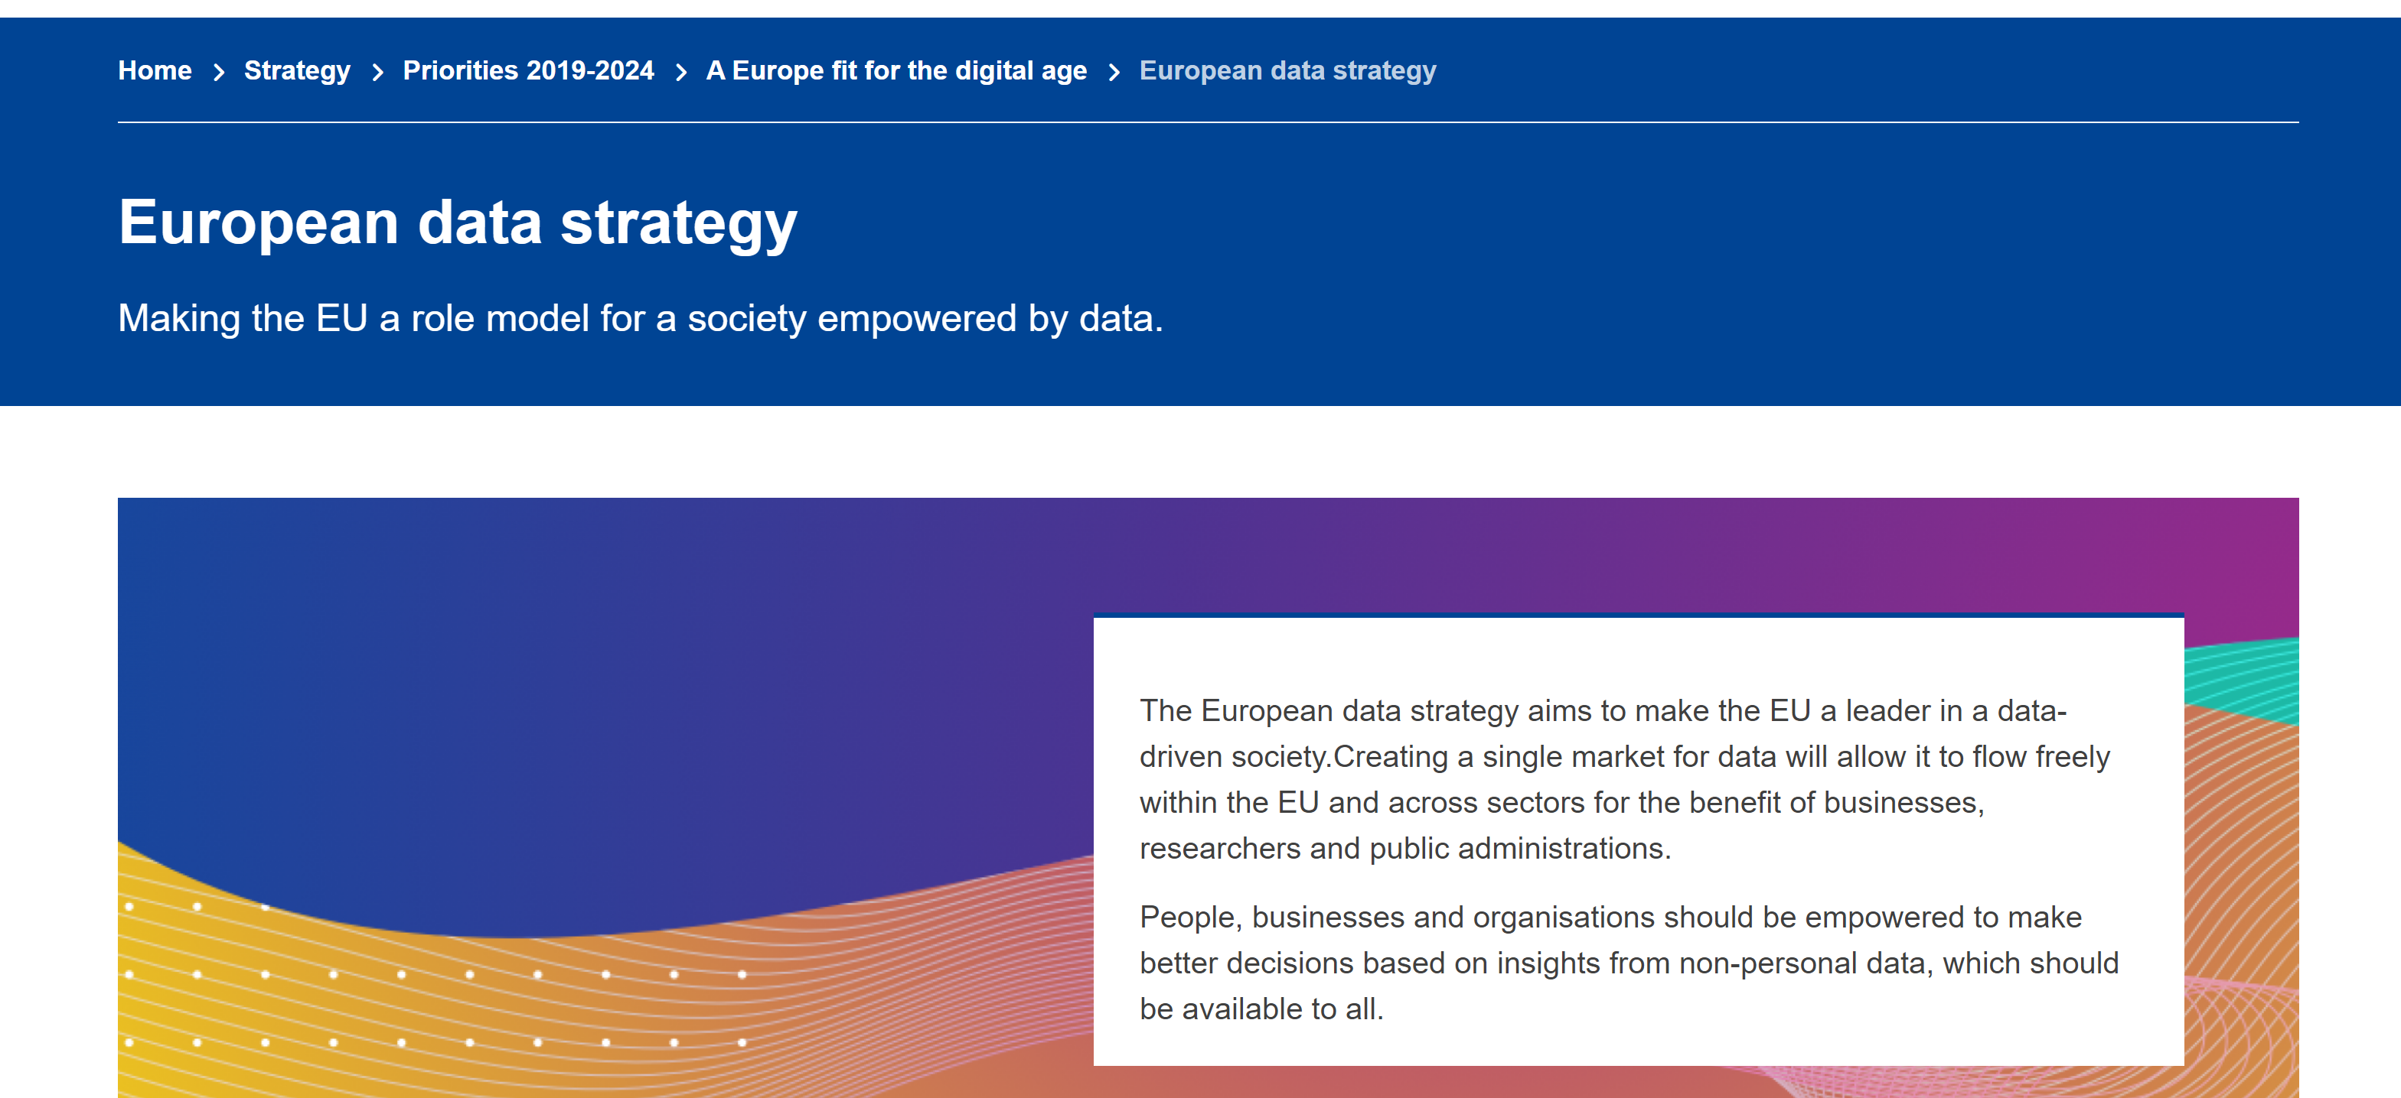
The EU as a role model for data-driven society?

Slide 6
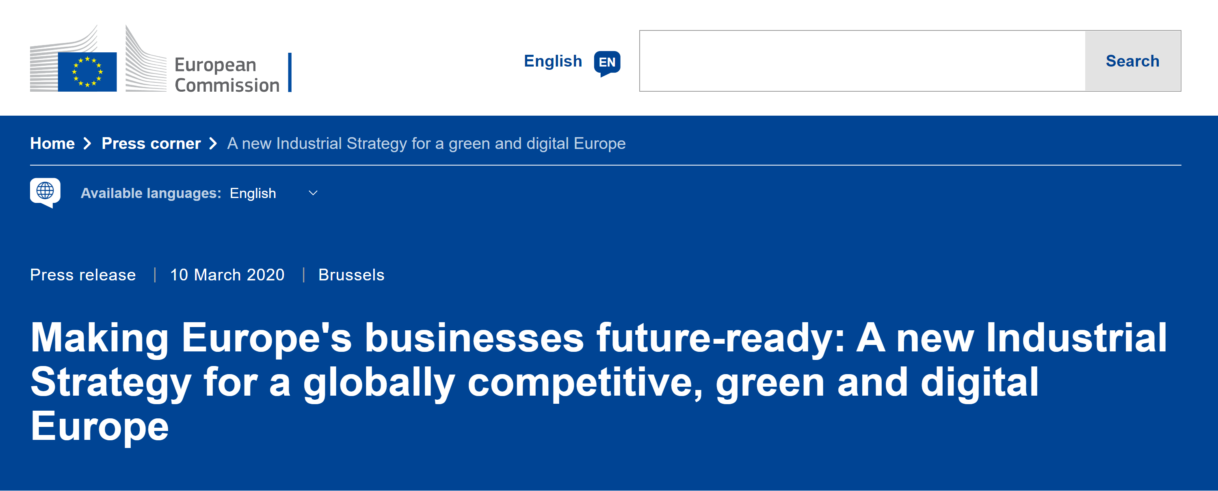
Twin transition to a green and digital economy?
….
EC Communication COM(2020) 103: “An SME Strategy for a sustainable and digital Europe”. Some key actions:
The Commission will upgrade the Enterprise Europe Network including with dedicated Sustainability Advisors and other sustainability services.
The Commission will develop Digital Crash Courses for SME employees to become proficient in areas such as AI, cybersecurity or blockchain.

Slide 7
Interaction between digital and climate
Digital
Impacts
Climate
Geographic locations of data centres as a result of changing climate and increasing climate impacts, supply chain security and access to critical raw materials for producing digital technologies | Direct | Energy and materials used in the production of digital technologies, design and durability of digital technologies, energy use and efficiency of data centres, e-waste management
Opening up new markets and closing old markets. Accelerating penetration of digital technologies as a result of changing needs and opportunities | Enabling | Improved operational efficiency of industrial plans and processes, better design and material efficiency, dematerialization
Behavioural change, economic and social change, governance structures | Systemic | Shifting behaviours and social norms, changing how we govern and monitor policies, changing how we organise social movements
Source: E3G blog Jun 2020 by Johanna Lehne &
Sara Dethier https://www.e3g.org/

Slide 8
The promise of fair data economy

Slide 9
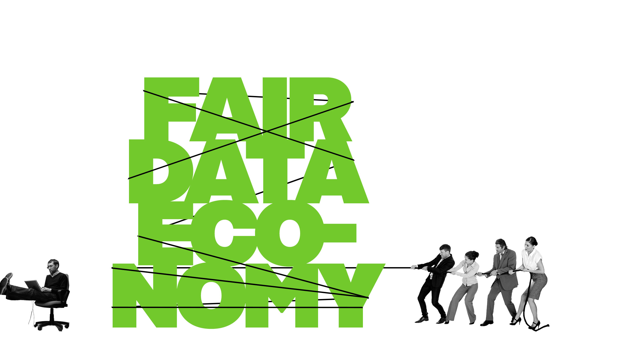
The part of the economy that focuses on creating services and data-based products in an ethical manner.
In the fair data economy data is shared between different parties with individuals' consent in a seamless and transparent way.
People use services that improve their well-being and everyday life, companies achieve growth through innovation, and the well-being of society increases
Vision is that Europe has a well-functioning data market, where companies that use data responsibly and open-mindedly succeed with smart services

Slide 10
UNDERSTANDING
Digital literacy at all levels. Improve both business and technical skills.
Rein in technology causing misery for individuals - Digital Rights are Human Rights
Act fast!
Learnings from European financial and telecom markets suggest focus on following topics*
- Accumulation and use of data assets
Services
Legislative actions
Self-regulation and standards
Implementation of the supervision
Source: Sitra Working paper
”The Future of The European Data Economy at Stake”, 1.10.2020

Slide 11
A more holistic view of EU wide data governance is needed for pooling the resources
Focus on data sovereignty
It is essential that people and organisations have functional control of their data and are easily able to reuse that data.
Cross-sectoral data sharing is the key for innovative services.
Rulebook templates for data sharing
model agreement templates for legal, business, technical and administrative rules
a range of control questions
code of conduct templates
CHOICES
Ethics
Trust
Privacy
Win-Win-Win
* Source: Innopay paper “Data sovereignty and soft infrastructure: key enablers of the European data economy”, 30.09.2020

Slide 12
Data Sovereignty as Design Principle?
Source: Presentation by Douwe Lycklama, Innopay Webinar “DataSovereignty Now: unleashing the benefits of data in line with European values”

Slide 13
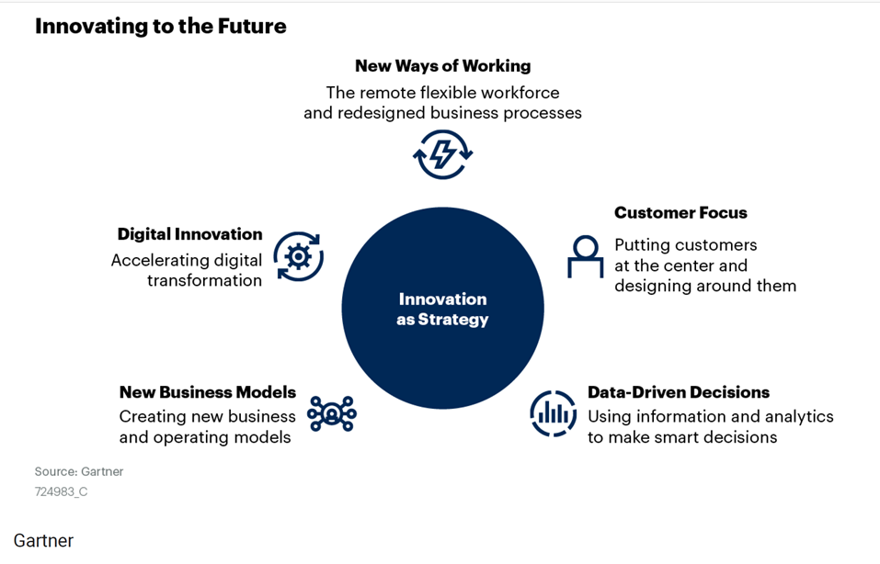
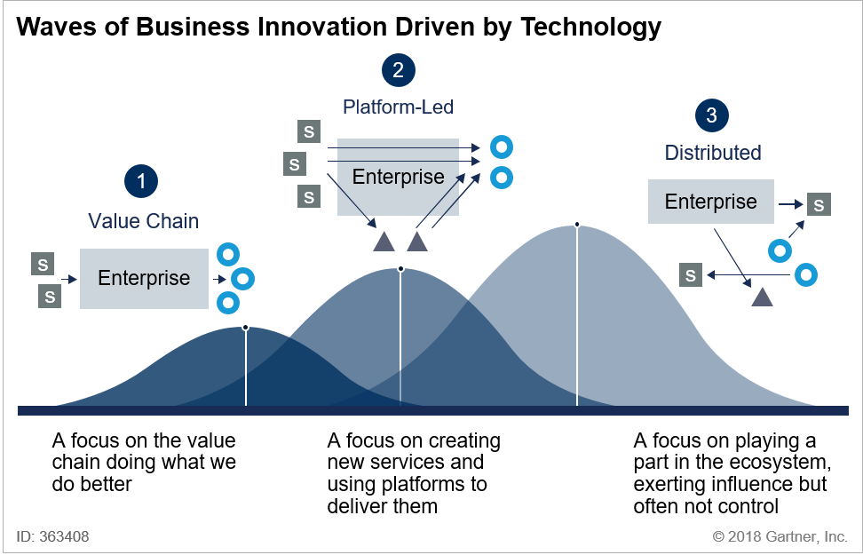
”Gartner says”…
Source: Gartner 2020 “Hype Cycle Special Report: Innovation as Strategy, ID G00724983
Source: Gartner 2018 ” 2018 Hype Cycles: Riding the Innovation Wave, A Gartner Trend Insight Report”

Slide 14
The main goal of the study: to find out why large companies should share their data and collaborate with smaller partners
Other goals:
Gain understanding of the current situation of business ecosystems in Finland. Gain insight about visions for the future
Interviews
Companies from three different ecosystems
Four expert interviews
Ecosystems can bring strategic opportunities and operational benefits to both large and small players - so large companies should share their data and collaborate with smaller partners as it brings benefits to everyone!
Experts are believing ecosystems are the future
At the moment, only some industries have started to utilize this business model. There is still a long way to go towards truly open ecosystems.
Ecosystems are not fast fix for problems, they require time, results and long-term attitudes from companies
Ecosystems should be considered in international level because also the competition crosses national borders
Companies do not collaborate, people do!
Source: Master’s thesis by Pinja Parkkonen, Sept 2020: “How to create new business opportunities in data sharing ecosystems with collaborative relationship between a large company and a SME”

Slide 15
We are not in the data economy yet – internet is a graveyard of data
90% data is not machine readable and thus unusable for automation
Data can’t be commoditised and put to real world use
Discovering and getting access to data is expensive
Business models are missing
The web is stuck on telco and protocol level. APIs do not understand need, purpose or economics.
Data is a product that must be exchanged like any other commodity in global economy
Interoperability
Commoditisation of data
Automated trust
INNOVATIONS

Slide 17
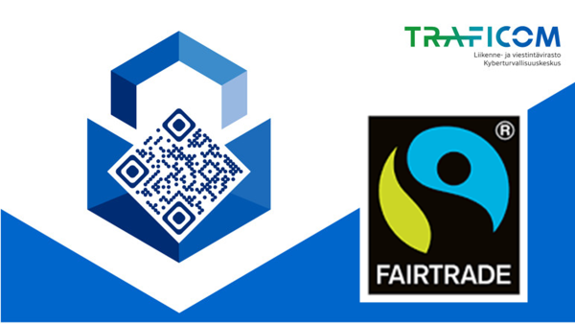
How to brand responsible digitalisation? Will transparent use of data lead to more sustainable future?

Slide 18
The key distinguishing characteristics of a data-responsible company
The company
has defined the essential data responsibility themes by reviewing data-related opportunities and threats both from its own perspective and from that of its stakeholders
creates value with the aid of data – even gratuitously – not only for its own operations but also for people, society and the environment
is transparent with about the collection, management, use, sharing and erasure of data
takes care that the rights of individuals exceed statutory requirements
understands its data repositories and has the competence required to use them
has defined ethical principles for developing and using algorithms and artificial intelligence
collects data appropriately and transparently and sees to good data life-cycle management
shares data with other stakeholders

Slide 19
Is there a potential for sustainable digital businesses build on data sharing?

