Slide 1
Welcome to
BUILDING A CULTURE OF RESILIENCE
@The Shift,
October 27th 2020
Speaker: Egbert Schram
+3584571375007
Egbert@hofstede-insights.com
The key to Culture

Slide 2
CONSULTING, TOOLING, RESEARCH
WE MAKE EMOTIONS AND PRACTICES TANGIBLE
Hofstede Insights has spent over 30 years helping some of the world’s largest organisations transform their intercultural and organisational challenges into business success stories and translating academic research into powerful actions.
WHO WE ARE AND WHAT WE DO
Intercultural management services
A Culture & Strategy Advisory and Analytics organisation
A core team of data technicians and communication professionals, and a global network of 150+ expert facilitators in 60+ countries
Consumer Culture Insights
Organisational culture analysis and strategic alignment

Slide 3
Overload of conflicting priorities
Notes:
People, both privately and occupationally, are overloaded with too many conflicting priorities

Slide 4
Building to last requires building a resilient organisational culture
Notes:
We feel the mental pressure when we enter organisations.
All organisations have an organisational culture.
Some organisational cultures are purposefully shaped to ensure constant adaptability to changing circumstances.
And this can be measured.

Slide 5
BUILDING A RESILIENT CULTURE
Making sure you have a “sustainable oil” e.g. culture
Symbols
National Culture
Heroes
Rituals
Organisational
Culture
Values
Practices
Practices
Notes:
Egbert speaking
Representing culture in a layered form like an Onion helps us understand it in a manner that we know hat’s more visible and easy to change and what is less visible and difficult to change.
The lack of visibility and the degree of difficulty to change increases as we move from the out layer to the core of this Culture onion.
At the outer most layer there are symbols : such as your Logo LTI, your tagline ‘Let’s Solve’ and so on
Next layer is where you have your Heroes – could be inside the organization our outside, could be Brand personalities such as Sachin Tendulkar, Roger Federer or , could be your promoter, could even be a fictionalized character such as Superman
Rituals: The way you greet and meet ; celebrate ; give gift / bonus every Diwali
Now all of these i.e. Symbols , Heroes, Rituals collectively define your practices in your organization and they constitute your Organization Culture.
If we peel all these layers we reach the core that is formed of the National identity. LTI in India is different from LTI in US if LTI US is formed by American nationals or LTI UK, if that organization is predominantly resources by Brits.
Our focus today is this Core formed out of National Culture.

Slide 6
CULTURE AND STRATEGY: THE SOLUTION
The 4 rules of making culture work for you
Understand your existing organisational culture (measure)
Understand your playing field
(external pressures)
Decide on what should be your optimal culture (strategic choice) / ensure alignment with strategic goals
Culture is a direct balancing acts with your strategy - it will either slow things down, or speed things up. Ensure consistency from the inside out and vice versa.
Strategy + (the right) Culture =
Sustainable organisational performance
6
Source: Business School Netherlands; Revzilla Motorsports LLC, Hofstede Insights
Notes:
Okey speaking

Slide 7
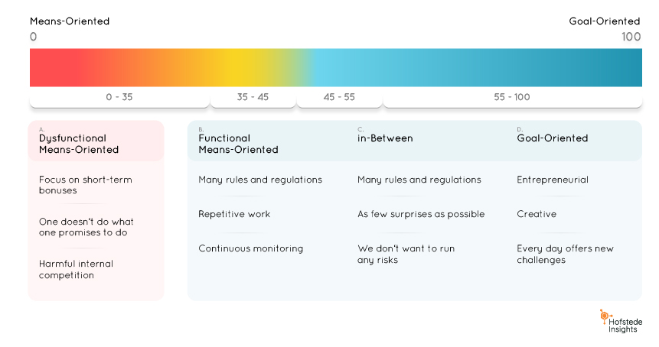
Go to www.menti.com and use the code 21 75 10 1
Go to
our stand to get the answer
CASE STUDY
READY FOR A NEW STRATEGY?
Company A works in the medical product sector. It is extremely efficient.
The organization faces problems with the speed of innovation. The new strategy calls for agile and lean thinking.
What should their optimal culture be on
goal orientation?

Slide 8
Connect with me on LinkedIn
Go to the app in the search bar select the QR icon
Egbert Schram
egbert.schram@hofstede-insights.com
+358 4513 75 007
Mikonkatu 17a
00100 Helsinki
Finland
sales@hofstede-insights.com / Hofstede Insights HQ / Mikonkatu 17 A 00100 Helsinki, Finland

