Slide 1
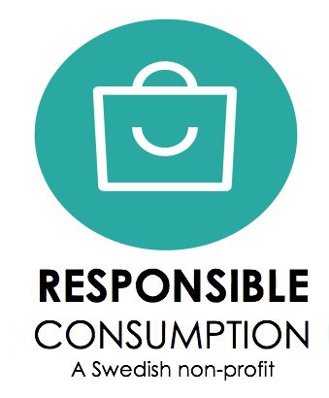
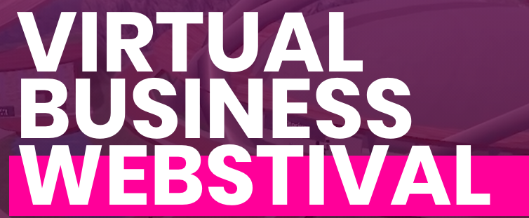
Work and consumption in the no bullshit-era
Alexandra Davidsson
Secretary General the Swedish Association for Responsible Consumption
Notes:
Present myself

Slide 2
Millennials make up the no bullshit-generation in work and consumption,
preferring freedom over security and sustainable values over the price tag.
Notes:
No – bullshit generation – what do I mean? That’s what I call them
No green washing, educated, wants to make a difference
Especially in the Nordic region
I argue that this translates to the consumption patterns, workplace, and their identity

Slide 3
Circulent – the consumer of the future
The Circularity Gap Report
The Nordic context
Today
Tomorrow
Notes:
Circularity Gap report shows world is now 8,6% circular, so huge revenue and business to be done here
In order to achieve a regenrative approach and reach the goals in the Paris Agreement, the IPCC report showed goal nr 12 affect all the other ones
2019 Nordic council of ministers
June 2020 – SDG index – July 2020 Circular Ecnomy approach
My point is – we’re in a momentum and a lot of things are changing
Corona – changed the way we work, and I believe that this will only continute.
The consumers of the future, and a true sustaianble consumer, is a circulent. And I believe that this group will be th ones adopting it fastest, we can already see thise trends
Millenialls – Circularity Gap Report – shows – only ask for more digital and circular goods

Slide 4
Trendspotting
Your conscious customers and employees
Work / life balance even more important
Following the energy-curve
Resonance
Notes:
Having this in mind, the background and the climate we operate in, I argue that these values and identity, the way of living is spread even into the workplace.
As they enter the workforce and climb the (non-)corporate ladder, they become your conscious customers and employees. They are aware of the interdependence between individuals and companies and act accordingly.
There is no green-washing and the climate how we work is changed.
It will be more important than ever to follow our energy curve – both physically, but also mentally. How we feel about things, what we idenity with etc
The resonance will be even more important – to feel good in the heart

Slide 5
ROUNDTABLE DISCUSSION 40 MIN
Do you agree with the discussion?
In the light of this background, will circulents thrive in your business model? (Think both what you offer your costumers, but also your employees)
Do you believe distance work is here to stay?
Do you believe that digital work is here to stay?
Notes:
Join Alexandra in a round table discussion on what does this mean for the way you deal with your employees or your product.
Circulents – what they will ask for
Do you agree with the discussion?
In the light of this background, will circulents thrive in your business model? Think both what you offer your costumers, but also your employees

